Slide 1










DIGITAL
PORTFOLIO
NAME:MENAKA . S
REGISTER NUMBER : 34624u18051
DEPARTMENT:B.SC. COMPUTER SCIENCE
COLLEGE/UNIVERSITY: M.M.E.S. WOMEN’S ARTS AND
SCIENCES COLLEGE

Slide 2

PROBLEM STATEMENT
PROJECT OVERVIEW END
USERS TOOLS AND
TECHNOLOGIES PORTFOLIO
DESIGN AND LAYOUT
FEATURES AND
FUNCTIONALITY RESULTS AND
SCREENSHOT CONCLUSION
GITHUBLINK

Slide 3


PROBLEM
STATEMENT
In today’s digital era, traditional resumes alone are not enough to
showcase skills and project effectively. Many students and
professionals lack a structured online presence to highlight their
work.Adigital portfolio provides an interactive and accessible platform
to present achievement, skills and experience.

Slide 4

PROJECT
OVERVIEW
Briefsummaryofmy project What my portfolio contains
(about me, projects, skills, contact). Main idea:
showcase personal achievement, skills, and projects.

Slide 5
WHO ARE THE END
USERS?
Students (academicprojects,
resumes). Job seekers (to share
with recruiters).
Freelancers (to show clients). Professionals(to
highlight experience and achievement).

Slide 6

TOOLS AND
TECHNIQUES
Html:structure (pages, sections). CSS: styling (colours,
layouts,
responsiveness). JavaScript: interactively(navigation menu,
animation, from validation). Mention code editor (VS code)or
CODEPEN and hosting platform (GitHub pages).

Slide 7

PORTFOLIO DESIGN AND
LAYOUT
section
included:
Home/ about
my Projects
Skills
Contact Responsive layout
(mobile+desktopview).

Slide 8
FEATURES AND
FUNCTIONALITY
Naviation barwithsmooth scrolling.
Project showcase with images/details.
Interactive elements (hover effects,
animation). Contact form (with
validation).
Responsive design for all
devices

Slide 9
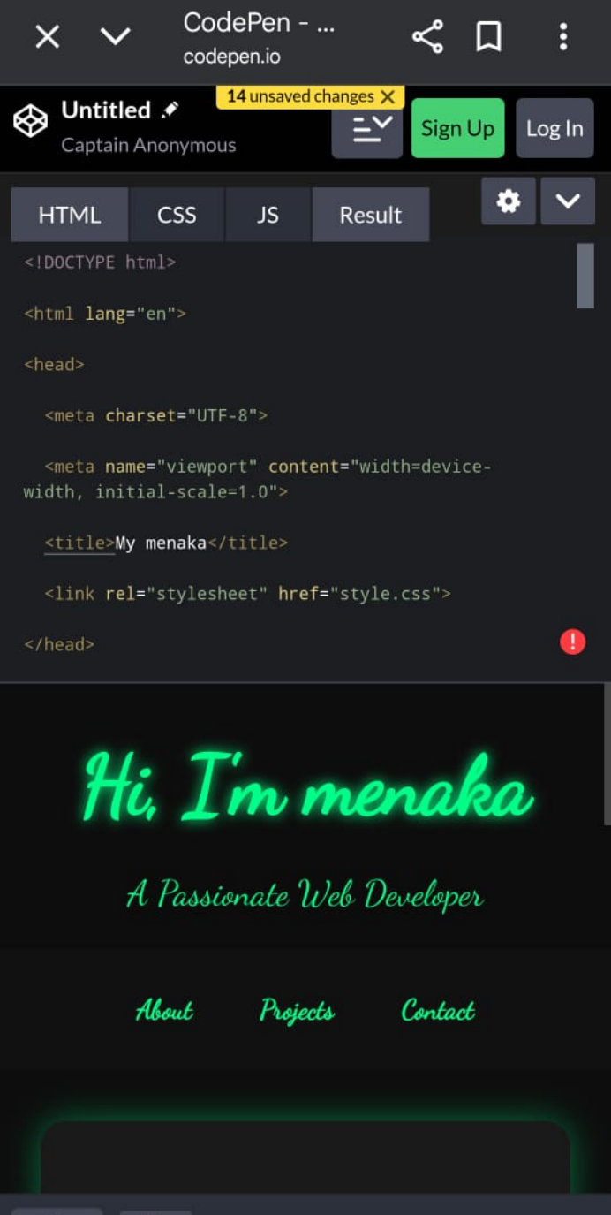
RESULT AND
SCREENSHOT
Screenshots of each
section Before
vs after
(plain HTML: with CSS&JS)

Slide 10


CONCLUSION
Highlights of my project Final
summary
Benefits of
society

Slide 11
Thank
you

